Slide 1
Analytics by Hitachi Vantara
Pentaho Data Integration and Analytics Platform

Slide 2









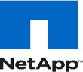











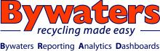

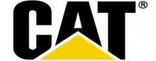
Over 1,500 Customers
Financial Services | Retail | Internet
Technology | Healthcare/Medical | Media/Entertainment
Government | Manufacturing | Energy

Slide 3
Agenda
About Hitachi Vantara
Data-driven outcomes
Financial services use case
Demonstration and presentation on Pentaho

Slide 4
About Hitachi Vantara “Beyond ETL”
Solution | Value
Hardware/storage | Best-in-class storage
HCI/HCP | Content platform and management for search, indexing and sharing
REAN Cloud | Move entire workload to a public cloud solution seamlessly
IoT/sensor technology | Customer cannot easily manage particular data, e.g., video, and/or wants a “Smart” solution
GDPR/Anonos Compliance | Save and monetize GDPR data for competitive advantage
Drift | Manage infrastructure performance and reliability via a single console
Mainframe Offload | Can significantly reduce cost of mainframe storage and increase efficiency
Pentaho Platform | Efficient and effective management of data, especially “big data”

Slide 5
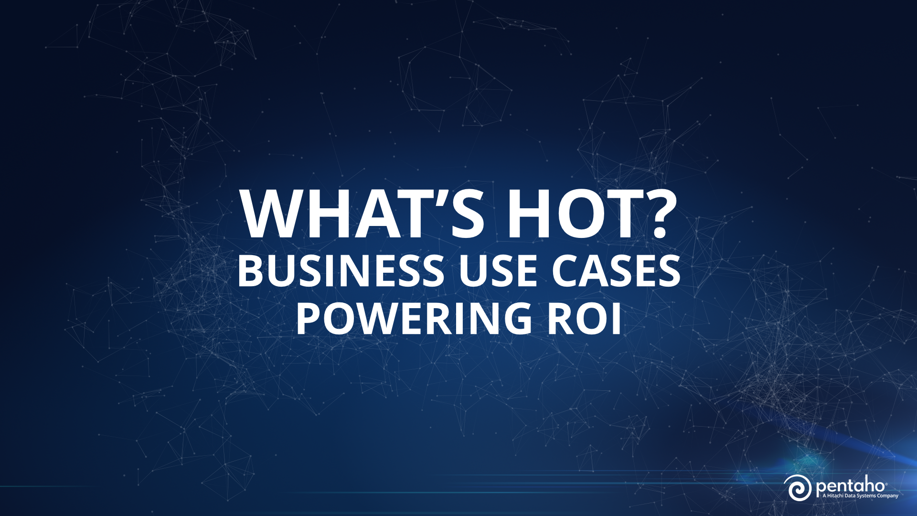
Notes:
SLIDE 17 (BUSINESS USE CASES POWERING ROI)
SO, WHERE IS THE ROI— HOW ARE COMPANIES PUTTING BIG DATA TO WORK?

Slide 6



ROI-Driven Use Cases
IOT
Customer 360
Streamline the Data Lake
Security / Intelligence
Notes:
IOT
Customer 360
Data Warehouse Optimization
Drift

Slide 7
Financial Services Demo

Slide 8
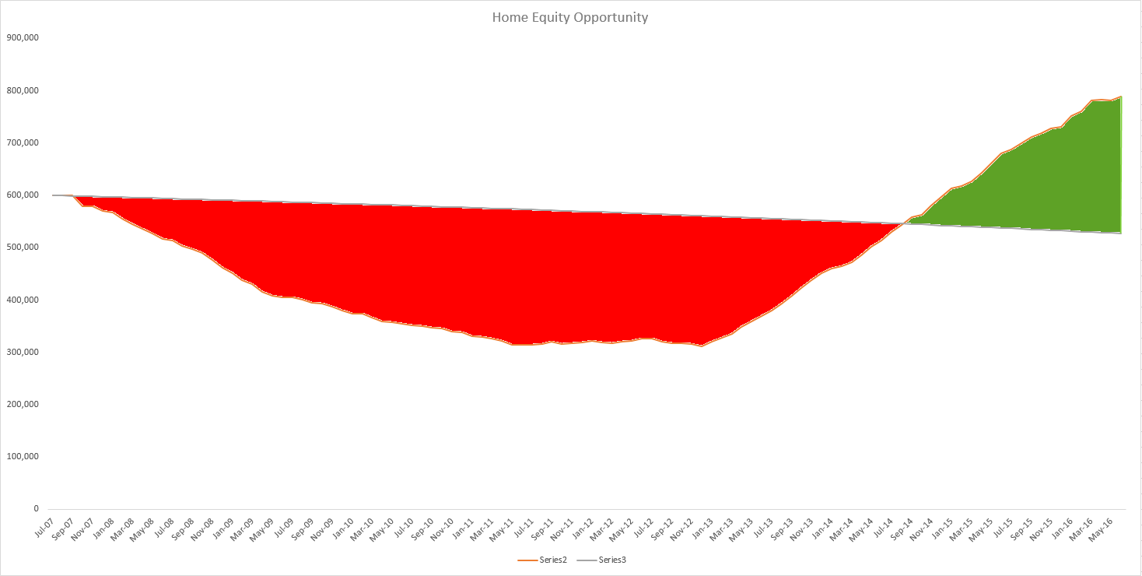
Identify High Equity Customers
High Home Equity Customers
Notes:
Enhanced 360 View of Customer is the #1 case reported across all research sources. Forrester has in-depth report on its importance and how orgs must expand to handle this new multidimensional customer view quickly or risk losing all.
Gartner on the Data Warehouse Augmentation (Optimization) case:
By 2014, 85% of currently deployed data warehouses will not scale appropriately to meet new information volume and complexity demands.
By 2016, 75% of existing data warehouses will fail to include content analysis support and will be scheduled for retirement.
Gartner industry study:
the most common planned approach to analyzing big data was to parse the data and load its resultant rationalized components into a data warehouse
Timeline is 12 months so this may be their short-term strategy
LDW Preso at BI Summit:
• 55% of organizations say they will not put Big Data in the DW in the next 12 months – will leave it in a separate data mart/store
• 17% will load it but don’t have a plan
• 28% will load it and have a plan
• 14% will modify ETL and load all.
• 9% will summarize and load.
• 9% will federate Big Data and the DW data.
EDW Optimization case is only one that is PDI/Integration-only focus. All others are Analytics along with Integration.

Slide 9

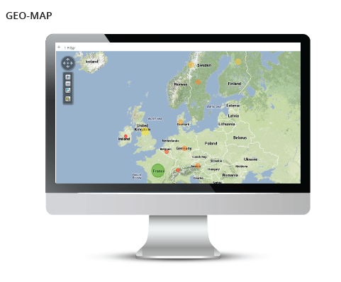






Customer 360 – Retail Banking
Web API Call Zipcode Traffic
Custom Demographic
Pentaho
Data
Integration
Hadoop Cluster
Company Website Clickstream
Identify high-equity mortgage customers browsing home equity line products online to upsell with home equity loans.
Mortgage Application Data

Slide 10
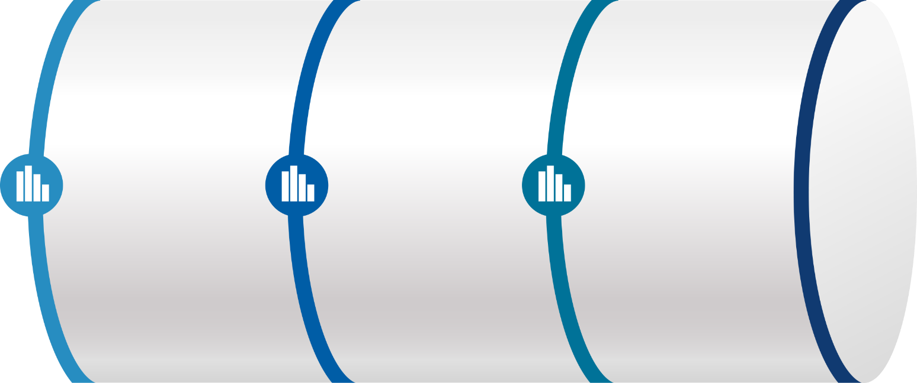
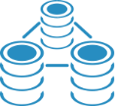


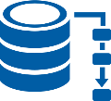


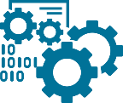
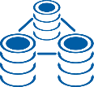

End to End Approach
DATA ENGINEERING
DATA PREPARATION
ANALYTICS
Cleanse Conform Shape
Refine Virtualize Blend
Visualize Build Score
Transform Ingest
Orchestrate Prepare Enrich
Analyze Model
Managing and Automating the Pipeline
Administration
Security
Lifecycle Management
Data Provenance
Dynamic Data Pipeline
Monitoring
Automation
Notes:
None of our competitors have the breadth of capabilities found in Pentaho – not one of them can support the entire analytic data pipeline – they can do some portions, but not all – really highlighting that Pentaho really does touch all aspects of the pipeline, while our competitors can’t – and that we have partners that we orchestrate (melissa data) to support very specialized use cases – like address validation – also R and Python for advanced analytics – extending the pipeline
So we are going to take a high level overview approach to the Pentaho Platform and how I like to do this is by taking a journey through the data pipeline and show you how the Pentaho platform can be the tracks that keep your data train on course.
Pentaho is
End to End Platform giving you the ability to manage your data pipeline taking you from the data engineering to the data prep to the analytics. All in a no code drag and drop environment. Allow you to manage administration, security, data governance automation and much more.

Slide 11


Introducing Pentaho
Pentaho Overview
Pentaho BA Suite consists of Data Integration (DI) and Business Analytics (BA) components
DI Components allow you to connect to and extract and prepare data from diverse data sources such as relational databases, NoSQL databases and Hadoop.
BA Components help you design metadata model, create reports and dashboards, and analyze your data.
Notes:
The Pentaho BA Suite consists of Data Integration and Business Analytics components. Data Integration allows you to connect to any and all of your various data sources including relational databases, big data sources, NoSql, Hadoop, flat files, Excel … enrich, enhance, blend and cleanse these data sources and provide extracts and updates to other data sources. The business analytics components allow you to design a metadata or business model, create your own reports, charts and dashboards, and analyze your data in a self-service environment.

Slide 12
What Is Pentaho Data Integration?
Graphical
Scalable
Embeddable
Notes:
To help you get acquainted with PDI, I want to highlight three of its key aspects –
First, from a user perspective – it’s a highly intuitive graphical user interface for data orchestration and transformation. As you will see first hand in our demo the interface is easy to use and its point and click which means you don’t have to be a coding expert to use.
Secondly, it’s highly scalable, the powerful meta data driven engine can quickly pulling data from any data source into your transformations and allows you to scale up or scale down as needed.
And finally its technology that is pluggable and easily customizable you can even embed our data integration engine into your current applications. Providing value by allow you to take advantage of its power while easing its adoption by embedding it in applications that your users are already comfortable with.

Slide 13
Pentaho Data Integration General Overview
Notes:
Build out Simple Transformation-
Getting Started: 1. Preview
2. Data Cleansing
3. Data Enrichment
4. Analyzer
5. Publishing Models to Repository

Slide 14




Data Onboarding
Ingest Procedures
Ingest Procedures
Ingest Procedures
Ingest Procedures
Ingest Procedures
Ingest Procedures
Ingest Procedures
RDBMS
Ingest Procedures
Ingest Procedures
Ingest Procedures
Ingest Procedures
Ingest Procedures
Ingest Procedures
Ingest Procedures
Ingest Procedures
Ingest Procedures
Ingest Procedures
Ingest Procedures
Ingest Procedures
Ingest Procedures
Transform & Store
Files
Disparate Data Sources
Ingestion Processes
Transformations
Notes:
When you start with only a few files and data sources managing your ingestion procedures or code could be fairly simple. Click
But as your disparate data sources grown so does the complexity of your ingestion process adding more and more procedurecs for each data set and source.

Slide 15
Data Onboarding with Pentaho Metadata Injection
Metadata
RDBMS
Ingest Procedures
Ingest Procedures
Ingest Procedures
Ingest Procedures
Ingest Templates
Ingest Procedures
Metadata
Transform & Store
Files
Disparate Data Sources
Ingestion Processes
Transformations
Notes:
Pentaho can reduce the amount of ingestion procedures and code by replacing them with Ingestion Templates that can be used on a multitude of different files and data sources
by pulling that meta data information at run time an injecting it into your transformation templates.

Slide 16
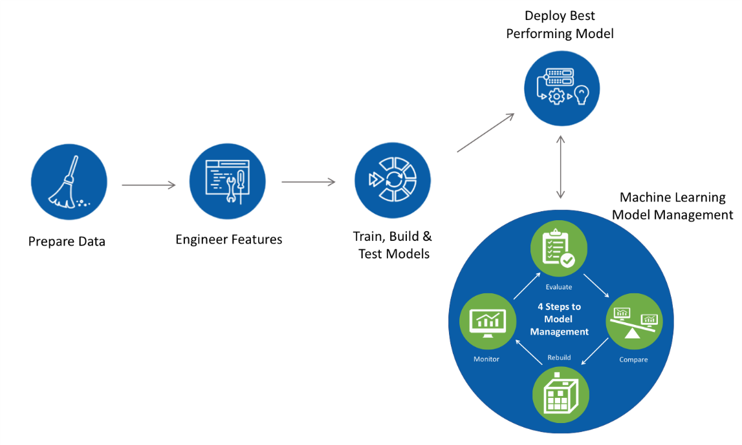



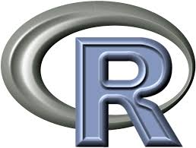
Data Science Enablement
Drag-drop data preparation and feature engineering
Operationalize predictive model into existing data pipelines
R, Python, SparkML, Weka
Plug-in Machine Intelligence
Notes:
Use Machine learning model management to evaluate model compare and rebuild your data models. Bring your own predictive models which you can paste as a step within a transformation. Then use Pentaho to operationalize those models. By Preparing the data, training, building and testing those models deploy the best performing model then use the iterative process of machine learning model management to evaluate, compare, rebuild and monitor those models.

Slide 17
PDI DEMO Metadata Injection & Data Science Enablement
Notes:
Asset: Metadata Injection
Show Template of Metadata Injection
BIO ME Dashboard (For SDR

Slide 18

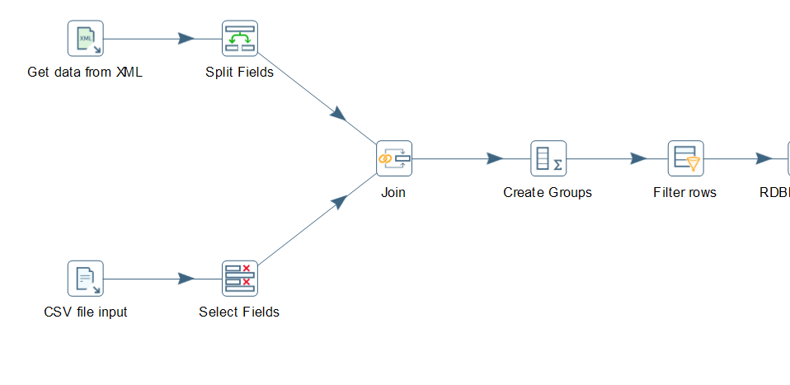
Pentaho Data Integration
Support for any and all data sources
Drag and drop environment to blend, integrate and prepare data
Data Marts on Demand via “Streamline Data Refinery”
Easily operationalize machine learning models written in R, Python and Weka
Notes:
Support for in-cluster Hadoop execution for linear scalability in a blended data world
Support for emerging big data ecosystem technologies and distributions with our adaptive big data layer
Visually inspect data in-flight, at any step in the data integration process, not just at the end

Slide 19
Data Driven Insights Demo

Slide 20



Streamlined Data Refinery
Web API Call Website Traffic
Self Service Data Request
Architected Data on Demand
Analyzer
Custom Demographic
Pentaho
Data
Integration
Pentaho
Data
Integration
Hadoop Cluster
Analytical Database
Website Clickstream
Reports
Mortgage Application Data

Slide 21

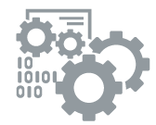
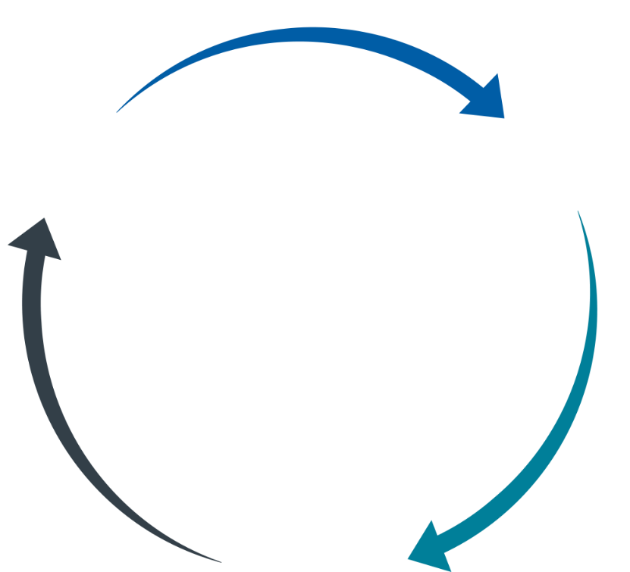
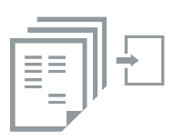
Streamlined Data Refinery Blueprint A user-driven and governed process
User initiated data request
Blending and refining any data
Request
Refine
Governance
Publish analytic data sets
Publish
Automatically generate data model
Notes:
User Request initiates a transformation and automatically creates a data model which is then published to the user.

Slide 22

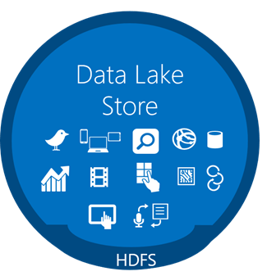

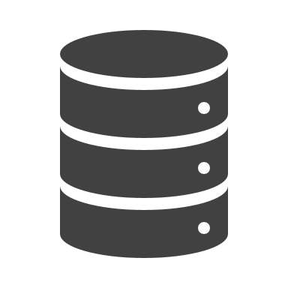




Evolving Enterprise Data Architectures
Network
Pentaho
or
Existing
Scripts
Location
Web
PDI
Analytical DB
Analytics
Social Media
On-Demand
Integration & Blending
PDI
Customer
Pentaho
or
Existing
ETL
Provisioning
PDI
Billing
BI Tools
Data Warehouse
Data Marts
Notes:
Before we jump into our Overview of PDI. Let’s First take a look at the Evolution Enterprise Data Architectures
For years organizations have invested in data warehouses, data marts and ETL development to deliver data to the business and provide context to their information.
But Since then things have changed and new data sources have emerged. With the introduction of new data sources companies are beginning to look at things such as geolocation data, social media and sensor data to gain insight into their business processes. But as useful as these new data streams are they also present new challenges:
There may be huge volumes of data that are expensive to store in the data warehouse.
An then their is also the Variety right we may have unstructured or semi-structured data that doesn’t easily fit into a traditional relational database model.
3. In order to store and analyze these new data sources new technologies such as Hadoop, No SQL and a variety of other Analytical Databases and tools have been developed.
4. Also with these new tools and data streams come new ways to use this information. New opportunities and new ways to use this data.
We want to blend and integrate our data on demand directly from the data source. Without having to stage it in a data in data mart or analytic database.
We want to provide real-time, on-demand access to our data from dashboards and applications.
So we can see have quite a bit of complexity within this new paradigm. So, how do we blend the old with the new and how do we do it seamlessly without having to write up a bunch of complex code
5. This is where Pentaho Data Integration comes in. We answer this challenges by providing a platform to ease the pain of integrating data across all these systems.
Pentaho Data Integration (or PDI) provides ETL functionality for loading the data warehouse and data marts
PDI has broad connectivity to all sorts of new data sources and technologies
And it goes beyond traditional ETL to leverage all this infrastructure in new ways
This is why Pentaho is uniquely positioned to accomplish the movement and blending of data seamlessly and the best part about it is that its you don’t have to be a coding expert to use it.
Hadoop , Azure Data Lake, Amazon S3

Slide 23



How do our clients achieve success?
A services partner for the full lifecycle
Workshops
Training
Implementation
Continued Support
Vision, solution and architecture workshops to create the right blueprint and best practice implementation plan
Training and certification programs to drive adoption, productivity, and skills development
Solution implementation to outsource the full or partial launch of your project to a reliable and skilled team
Readiness assessment and health checks to review your current strategy and deployment to maximize ROI
Why trust us?
150+
750+
1500+
People
Trained and certified consultants and instructors
EXPERIENCE
Combined years of integration and development experience
PROVEN SUCCESS
Customers

Slide 24
Questions and Discussion

Slide 25
Thank You

